Slide 1
Making zines for nature
Tell your Nature Park story!

Slide 2
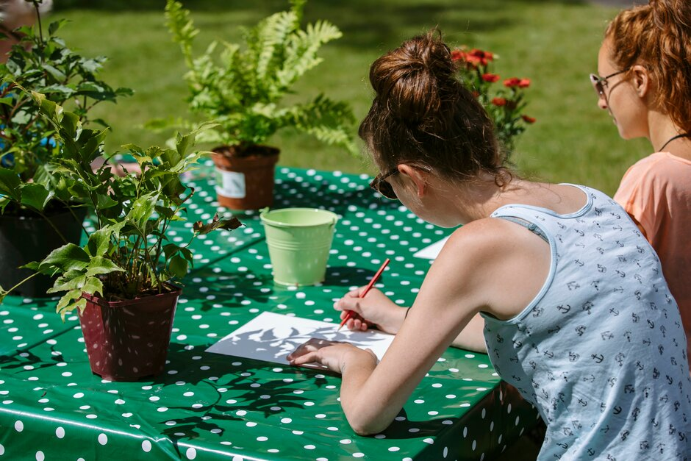
What’s a zine?
Did you know? The earliest known use of the word ‘zine’ is in the 1940s
Zines (short for ‘magazine’ or ‘fanzine’) are self-published or DIY books, booklets or pamphlets
Anyone can make a zine to tell people about something they care about!
They are usually made and shared to tell a story or share information – rather than to make money
© RHS, RHS/Helen Yates

Slide 3
Why do zines matter?
Zines are important because...
Anyone can make one! They can provide a voice for those who may not otherwise be heard
They can tell stories and share information that may not be given space in mainstream media
They can reach people that might not otherwise have learned about an issue
They can share real-life experiences, told in the way you want to tell them
They can make change happen!

Slide 4
A zine can be…
Handmade, printed or photocopied
Fact or fiction
Made by one person or a group of people
For a reader to learn something, raise awareness, take action, or just enjoy
Writing, images or both
As little as one sheet of paper or as many as you like
About yourself, something you are interested in or something you care about

Slide 5
A zine should be…
Limited edition, not mass-produced
Shared with other people
About something you care about or want to share with others
Creative!
Cheap and easy to make
A way to express yourself
Fun!
Unique

Slide 6
Think about your Nature Park journey so far...
Where did we start? What did you know at the very beginning? What did you set out to do?
What have we found out? What are the most interesting things you've discovered or learned? What matters the most to you?
What experiences have we had? What have you enjoyed? What haven't you enjoyed? What words would you use to describe your experiences so far?
What questions do we have? Are there things you want to know more about? What do we need to find out or do next?

Slide 7
What do you want to tell people about this journey?
Raise awareness about biodiversity loss or climate change
Inspire people to take action for nature and the environment
Share your nature observations (pictures, thoughts and feelings)
Encourage people to take notice of nature
Share a how-to or tips on a skill you’ve learned (like identifying bugs, or sowing seeds)
Tell a story about nature or your Nature Park
Something else?
Think about…
What interests you?
What matters to you?
What have you discovered or learned so far?
Who do you want to tell?
What is your aim?

Slide 8
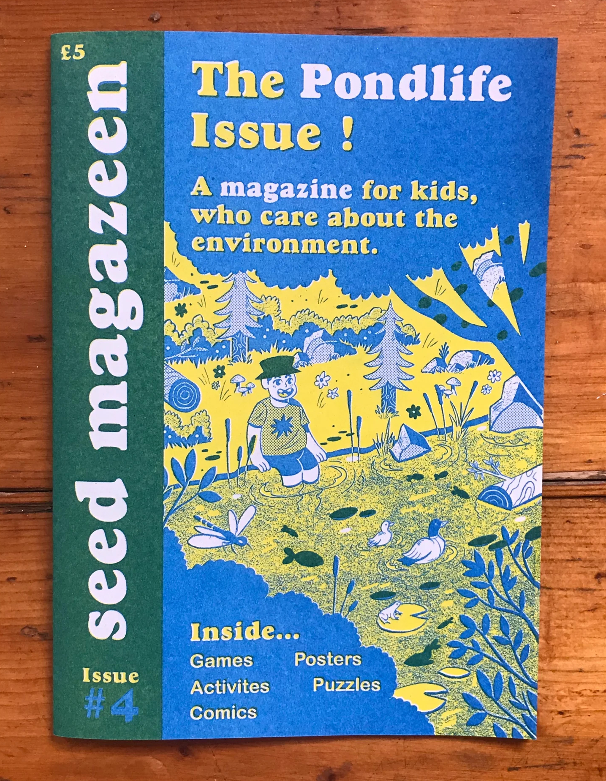
Tips from a zine-maker!
Lizzie Lomax is an artist and the co-creator of Seed Magazeen, a nature zine for children. Here she's given us her top tips for making a zine!
© Seed Magazeen
Don't be precious! Zines are all about DIY and they don't need to be perfect. If there are mistakes or misaligned pages, that's fine - that adds to the charm of a zine
Zines are usually about a specific topic. What is something very niche or obscure that you find interesting?
Pick a colour palette and stick to this. Collage, cut out, draw. Having restrictions can be a great way to achieve some interesting results​
Think of a catchy name for your zine - is it a one-off or part of a series? ​
Most of all...HAVE FUN! Be playful and enjoy making your zine
Notes:
You can see more of Seed Magazeen here: https://www.seedmagazeen.com/

Slide 9
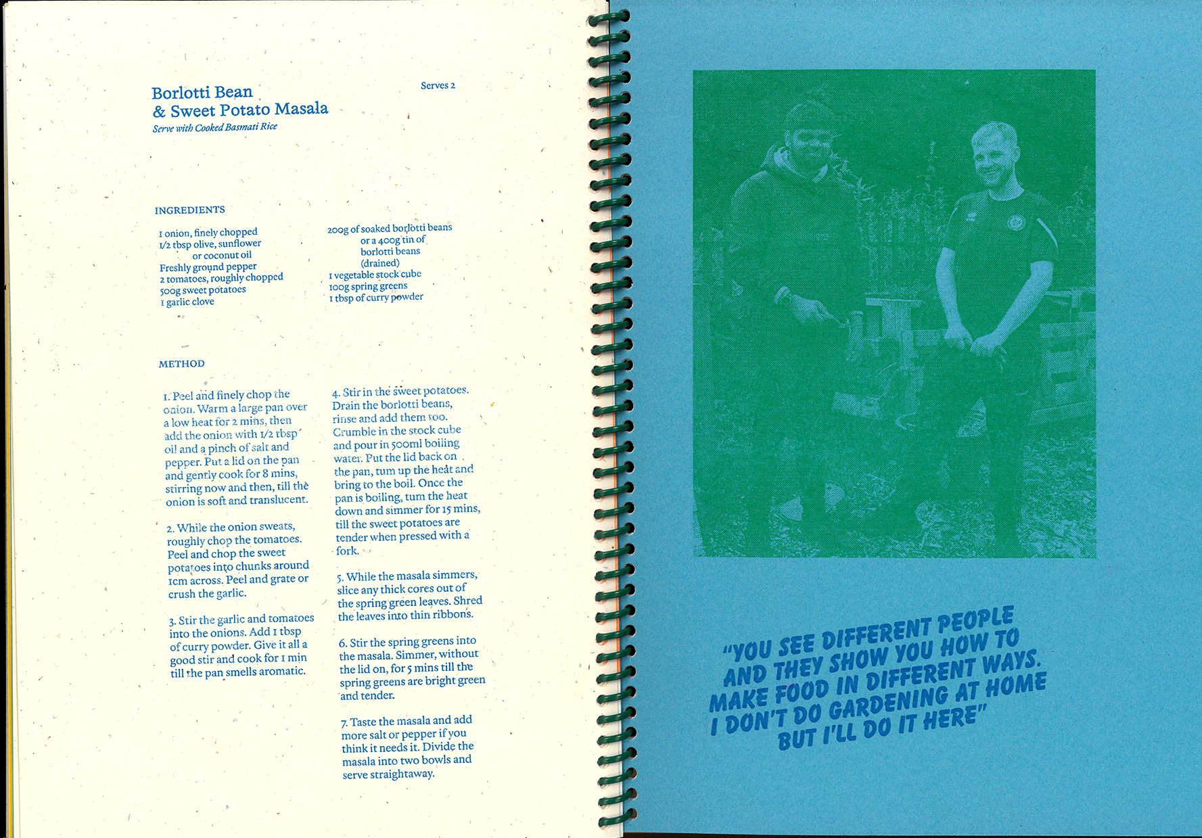
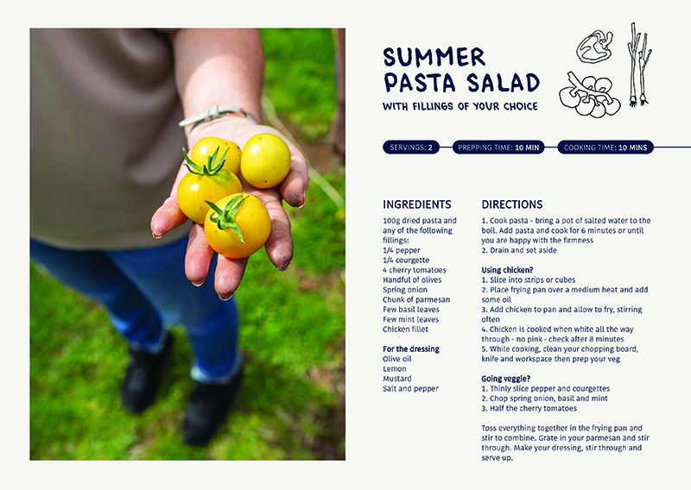
More examples of zines
Take a look at these zines which were created as part of a project between the Royal Horticultural Society and artists who were asked to help community gardening groups tell their story.
What do you think of these zines?
How are they different?
What do you like about them?
What do they tell us?
How do they make you feel?
view here
view here
Notes:
Home Grown Knowledge showcases the work shared with Gwen Riley Jones, Q Gardens, Strand Community Hub and Petrus Incredible Edible Rochdale (PIER) in Rochdale. Designed, risograph printed and bound by Amrit Randhawa.
Grow To Eat documents the Grow To Eat programme with Cranhill Community Development Trust. Designed by Callai Watson, cyanotype images created by Cranhill community members
You can find out more about the RHS collaboration with the Socially Engaged Photography Network, as well as more tips and resources here: https://www.rhs.org.uk/get-involved/grow-with-it/resources/share-your-community-gardening-story

Slide 10
To get you started...
Audience: Who is your zine for? Who do you want to talk to?
Issue: What would you like your zine to talk about? This should be the overarching topic you are interested in
Problems: What specific problem are you trying to address within your topic?
So what? Why should your audience care? Why is it important to talk about?
Solutions: What can be done to help? What do you want the people who read your zine to do about it?
Benefits: What good things will happen if the problem is solved? Who or what will benefit?
Spend 5 minutes writing down or discussing your answers for each of these questions
Notes:
These 6 areas are based on The Message Box tool by COMPASS, a science communication organisation. The Message Box helps you to frame your message in a way that is relevant for your audience. You can find more information on the tool here: https://www.compassscicomm.org/leadership-development/the-message-box/

Slide 11
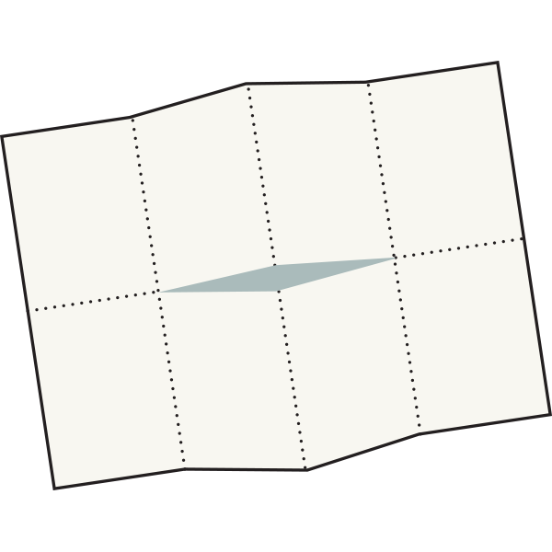
3 ways to make a zine
Pamphlet
Fold sheets of paper in half to make your pages, and staple them together
One-page zine
Use the printable template to make an 8 page zine from just one sheet of A3!
Accordion
Fold one strip of paper back and forth to create a zig-zag zine

